Slide 1
Physics 201
Winter 2013
Torque and rotation

Slide 2
Torque drives angular acceleration
Winter 2013
We seek a formula like Newton’s second law in the context of rotation – it will look like:
We have discussed torque and angular acceleration
The piece in the middle corresponds to mass for rotation and is called the moment of inertia
We must now discuss how to determine its value for various objects

Slide 3
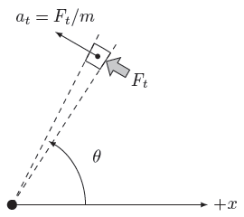


Moment of inertia depends on the distribution of mass
Winter 2013
Each piece obeys Newton’s second law individually

Slide 4
That sum hides the calculus – we use a table
Winter 2013
Object | Moment of Inertia
Circular ring
Circular plate
Hollow sphere
Solid sphere
Object | Moment of Inertia
Thin rod (center)
Thin rod (end)
Moment of inertia is smallest when mass is concentrated near the axis

Slide 5
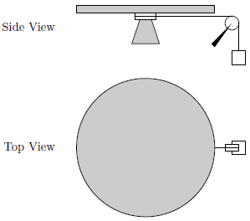
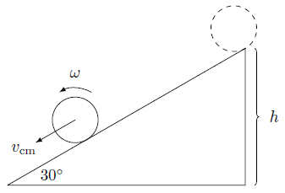
Some examples…
Winter 2013
Show me

Slide 6
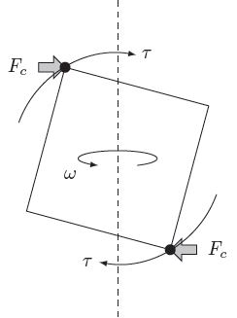
Free rotation – the moment of inertia is really a tensor
Winter 2013
If rotation is not along a line of symmetry, extra torque is required to support the rotation
This causes a wobble in the rotation: precession and nutation
Every object has a wobble-free axis – dynamic balancing

